Slide 1
Gipher
Ekta Dutt
Priyanka Mandke
Yashasva Paras

Slide 2
Introduction
Gifs are a crucial part of everyday conversation.
Users need just the right gif for the right emotion.
Gipher App will display various types of GIFs and provide an easy navigation of it to the end users.

Slide 3
Detailed Solution
The website will fetch data from a 3rd party API and display it to the users.
The site will provide features like “add to fav” to add the gifs to the favorite list and feedback to improve the overall site performance.
The site will provide easy navigation for the end users.

Slide 4
Existing Applications vs Envisioned Solution
Existing GIF-sites does not provide a user-friendly way to save the gifs that user would like to use later.
Gipher app will provide this functionality by providing the authenticated users an easy way to store/delete.
It also provides functionality to search gifs as per user’s needs.

Slide 5
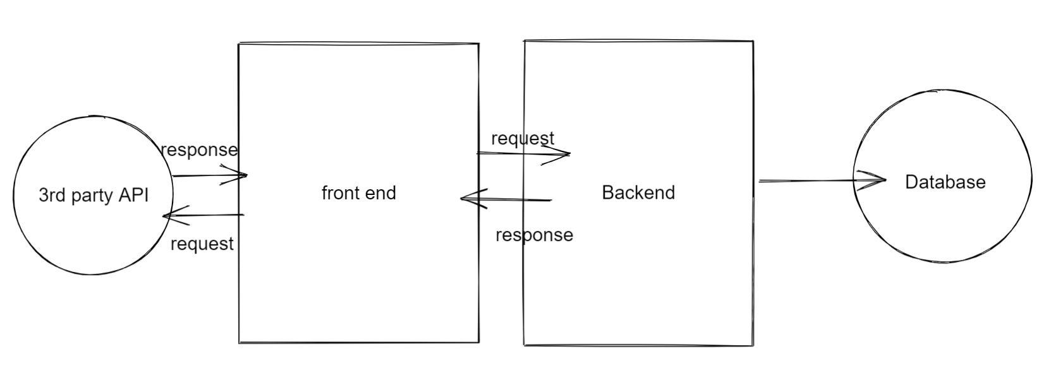
Project Flow Diagram

Slide 6
Technologies Used
Spring Boot
Hibernate
Mongo DB
MySQL
Docker
Angular
Protractor / Junit
Bootstrap
Microservices
Pipelines

Slide 7
Development Phase
Microservices
1. UserAuthentication Service
2. Favorite Service
3. Feedback Service
Containerization
Dockerization
Angular techniques
Login service, authentication service, router service, GIF Service, canActivate guard
Giphy API calls (Trending, Search)
Responsiveness

Slide 8
Phases & Timeline
Deploying our application to cloud.
Adding more features like share feature.
Recommendations based on user’s preferences.

Slide 9
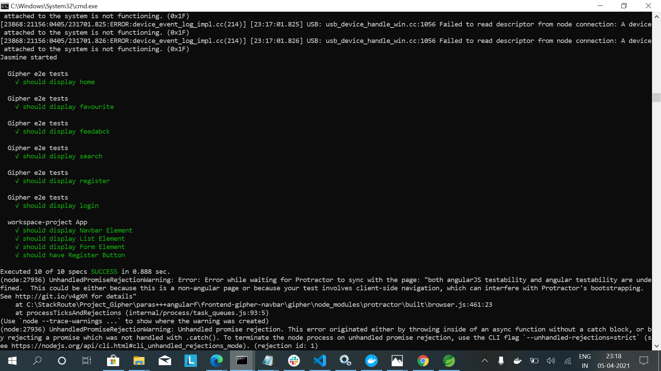
Experimental Results
e2e Tests

Slide 10
Conclusions & Future Directions
All internet users can search for gifs. However, only authenticated users can add/delete the gifs to/from favorite.
canActivate guard is implemented for guarding the route.
We learned about how backend and front end are connected and synchronized which was also the most challenging part.
The future directions will include deploying our application in cloud and a share feature enabling cross-platform sharing.
During the course of the project, we researched on how a user interacts using gifs.
We could definitely have a lot more research(including surveys) on how user uses gif in conversation.
Based on the data, we will customize UI and make things more user friendly.
The most interesting problem was how we can make our website standout in comparison to other alternatives.

Slide 11
Outcome
The website shows a wide range of trending gifs in home page.
Authenticated User is able to add/delete gifs to favorite.
Authenticated User is able to see the overall stats for site rating given by other users.
User is able to provide their own feedback.
The website is responsive.
User is able to search for gifs effectively.

Slide 12
THANK YOU

